Slide 1
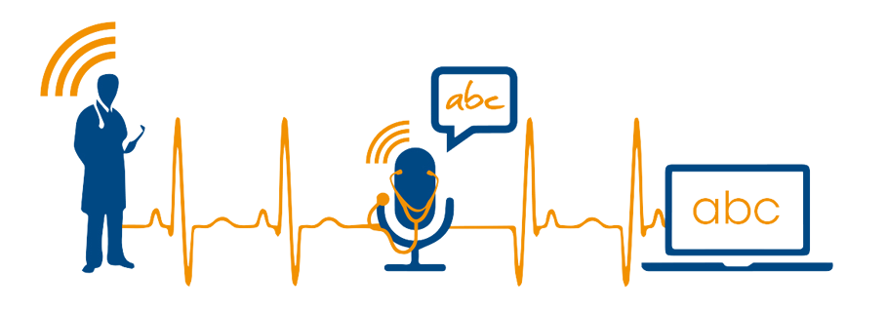
Speech Recognition

Slide 2
SPEECH RECOGNITION
A Process that enables the computers to recognize and translate spoken language into text. It is also known as "automatic speech recognition" (ASR), "computer speech recognition", or just "speech to text" (STT).

Slide 3
APPLICATIONS
Medical Transcription
Military
Telephone and similar domains
Serving the disabled
Home automation system
Automobile
Voice dialing (“Call home” )
Data entry (“A pin number”)
Speech to text processing (“word processors, emails”)

Slide 4
RECOGNITION PROCESS
Voice Input
Analog to Digital
Acoustic Model
Language Model
Feedback
Out
Speech Engine

Slide 5
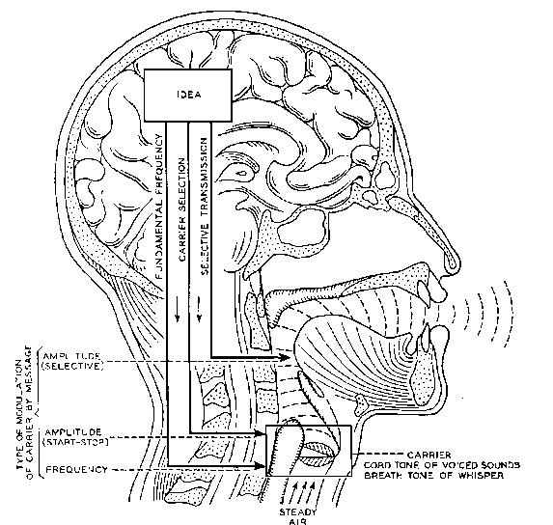
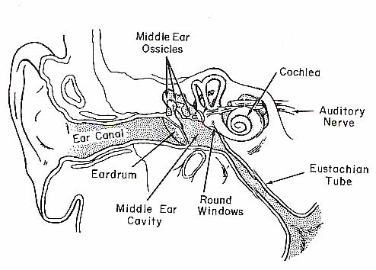

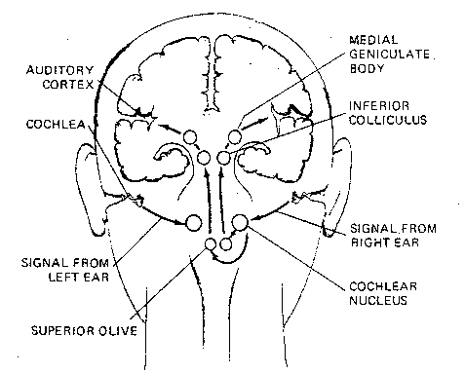
HOW DO HUMANS DO IT ?
Articulation produces sound waves which the ear conveys to the brain for processing

Slide 6
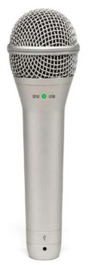
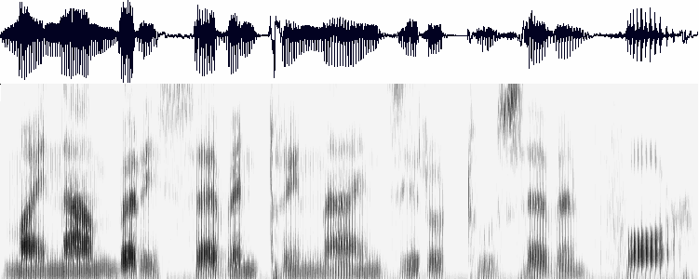
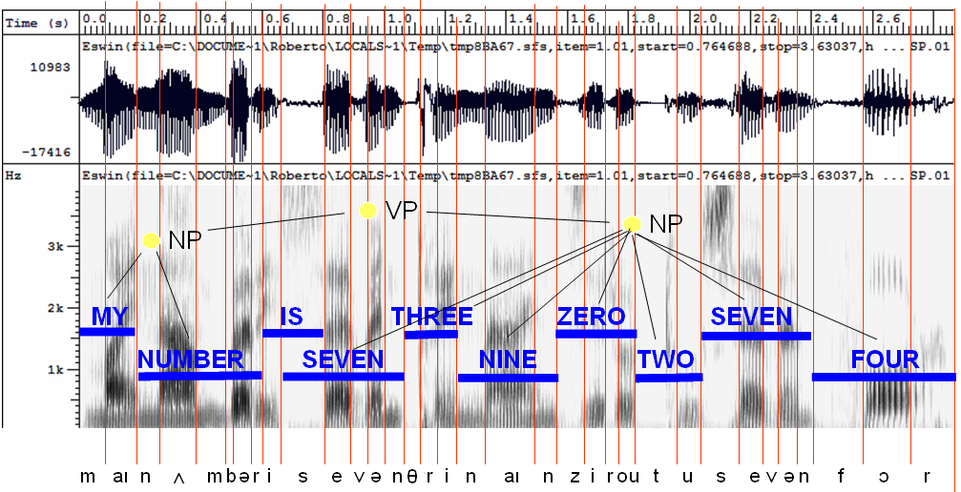
HOW MIGHT COMPUTERS DO IT ?
Acoustic waveform
Acoustic signal
Digitization
Acoustic analysis of the speech signal
Linguistic interpretation
Speech recognition

Slide 7
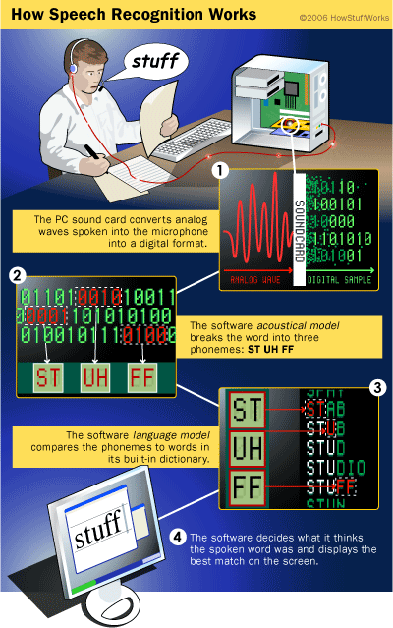

Slide 8
FLOW SUMMERY OF RECOGNITION PROCESS
User Input:
System catches users’ voice in the form of analog acoustic signal.
Digitization:
Digitize the analog signal.
Phonetic Breakdown:
Breaking signals into phenome.

Slide 9
FLOW SUMMERY OF RECOGNITION PROCESS
Statistical Modeling:
Mapping phenomes to their phonetic representation using statistics model.
Matching:
According to Grammar, phonetic representation and Dictionary, the system returns a word plus a confidence score)

Slide 10
TYPES OF SPEECH RECOGNITION
SPEAKER INDEPANDENT:
Recognize speech of a large group of people
SPEAKER DEPANDENT:
Recognize speech patterns from only person
SPEARKER ADAPTIVE:
System usually begins with a speaker independent model and adjust these models more closely to each individual during a brief training period

Slide 11
Approaches to SR
Template Based
Statistics Based

Slide 12
Template-based approach
Store examples of units (words, phenomes), then find the example that most closely fits the input
Just a complex similarity matching problem
OK for discrete utterances, and single user

Slide 13
Template-based approach
Hard to distinguished very similar templates
Quickly degrades when input differs from template

Slide 14
Statistics based approach
Collects a large corpus of transcribed speech recording
Train the computer to learn the correspondences at different possibilities(Machine Learning)
At run time, apply the statistical processes to search through the space of all possible solutions, and pick the statistically most likely one

Slide 15
What’s Hard About That ?
Digitization:
Analog signals into Digital representation
Signal Processing:
Separating speech from background noise
Phonetics:
Variability in human speech
Channel Variability:
The quality and position of microphone and background environment will affect the output

Slide 16
SPEECH RECOGNITION THROUGH THE DECADES
1950-60s (Baby-Talk)
‘They’ first focus on NUMBERS
Recognize only DIGITS
1962, IBM developed ‘SHOEBOX’ which can recognize 16 words spoken in English

Slide 17
SPEECH RECOGNITION THROUGH THE DECADES
1970s (SR Takes Off)
U.S. DoD’s DARPA initiate a research program called Speech Understanding Research Program.
Code Name was ‘HARPY’ which can understand 1101 words.
First commercial speech recognition company, Threshold Technology was setup, as well as Bell Laboratories' introduction of a system that could interpret multiple people's voices.

Slide 18
SPEECH RECOGNITION THROUGH THE DECADES
1980s (SR Turns Toward Prediction)
SR vocabulary jumped from about a few hundred words to several thousand words
One major reason was a new statistical method known as the hidden Markov model.
Rather than simply using templates for words and looking for sound patterns, HMM considered the probability of unknown sounds' being words.
Programs took discrete dictation, so you had … to … pause … after … each … and … every … word.

Slide 19
SPEECH RECOGNITION THROUGH THE DECADES
1990s (Automatic Speech Recognition)
In the '90s, computers with faster processors finally arrived, and speech recognition softwares became viable for ordinary people.
Dragons’ Naturally Speaking arrived. The application recognized continuous speech, so one could speak, well naturally, at about 100 words per minute. However, about 45 minutes training was required by the user.

Slide 20
SPEECH RECOGNITION THROUGH THE DECADES
2000s
Topped out 80% accuracy
2002, Google Voice Search was released, that allows users to use Google Search by speaking on a mobile phone or computer
2011, Apple’s Siri was released. Its a built-in "intelligent assistant" that enables Apple user’s speak voice commands in order to operate the mobile device and its apps
2014, MS Cortana was released. Its also a built-in “intelligent personal assistant” which can set reminders, recognize natural voice without the requirement for keyboard input, and answer questions using information from the Bing search engine.

Slide 21
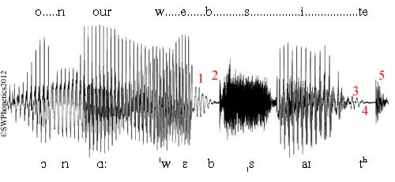
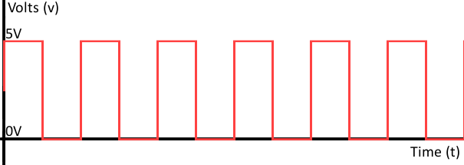
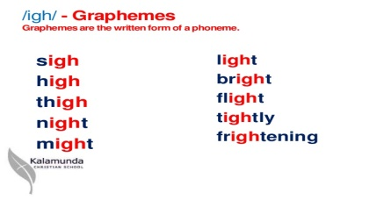
Artificial Neural Net
0011100101

Slide 22
Artificial Neural Net
DO IT YOURSELF
0011100101

Slide 23
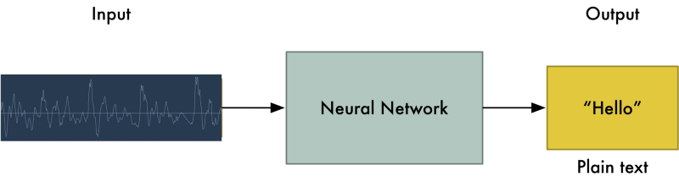
Artificial Neural Net
Sound wave saying ‘Hello’

Slide 24
Artificial Neural Net
But we aren’t quite there yet

Slide 25
Artificial Neural Net
But we aren’t quite there yet

Slide 26
Artificial Neural Net
The big problem is that speech varies in speed

Slide 27
Artificial Neural Net
The big problem is that speech varies in speed

Slide 28
Artificial Neural Net
One person might say “hello!” very quickly and another person might say “heeeelllllllllllllooooo!” very slowly, producing a much longer sound file with much more data. Both sound files should be recognized as exactly the same text — “hello!”

Slide 29
Artificial Neural Net
One person might say “hello!” very quickly and another person might say “heeeelllllllllllllooooo!” very slowly, producing a much longer sound file with much more data. Both sound files should be recognized as exactly the same text — “hello!”

Slide 30
Artificial Neural Net
Automatically aligning audio files of various lengths to a fixed-length piece of text turns out to be pretty hard

Slide 31
Artificial Neural Net
Automatically aligning audio files of various lengths to a fixed-length piece of text turns out to be pretty hard

Slide 32
Artificial Neural Net
To work around this, we have to use some special tricks and extra processing in addition to a deep neural network. Let’s see how it works!

Slide 33
Artificial Neural Net
To work around this, we have to use some special tricks and extra processing in addition to a deep neural network. Let’s see how it works!

Slide 34
Turning Sounds into Bits
- The first step in speech recognition is obvious — we need to feed sound waves into a computer.
- But sound is transmitted as waves. How do we turn sound waves into numbers?

Slide 35
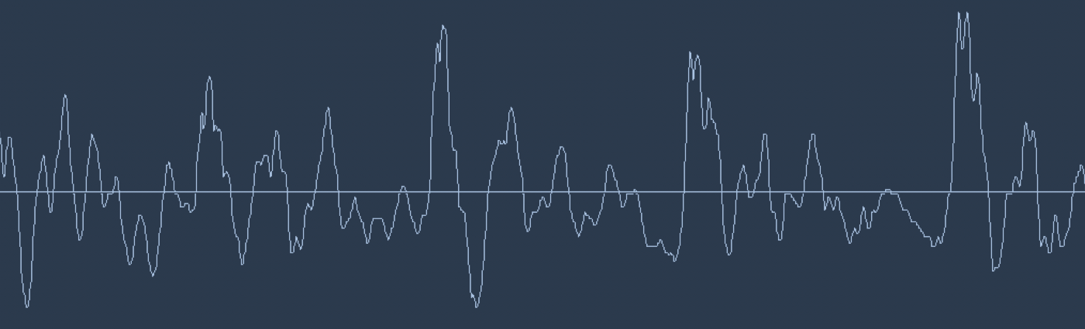
A waveform of saying “Hello”

Slide 36
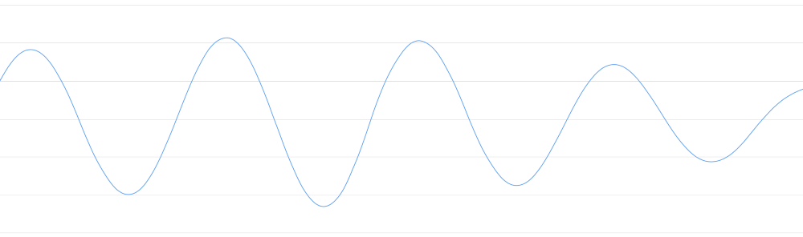
Let’s zoom in on one tiny part of the sound wave and take a look:

Slide 37
To turn this sound wave into numbers, we just record of the height of the wave at equally-spaced points:

Slide 38
This is called sampling.
We are taking a reading thousands of times a second and recording a number representing the height of the sound wave at that point in time.
Sampled at 16Khz (16,000 samples/sec).
Lets sample our “Hello” sound wave 16,000 times per second. Here’s the first 100 samples:
Each number represents the amplitude of the sound wave at 1/16000th of a second intervals

Slide 39
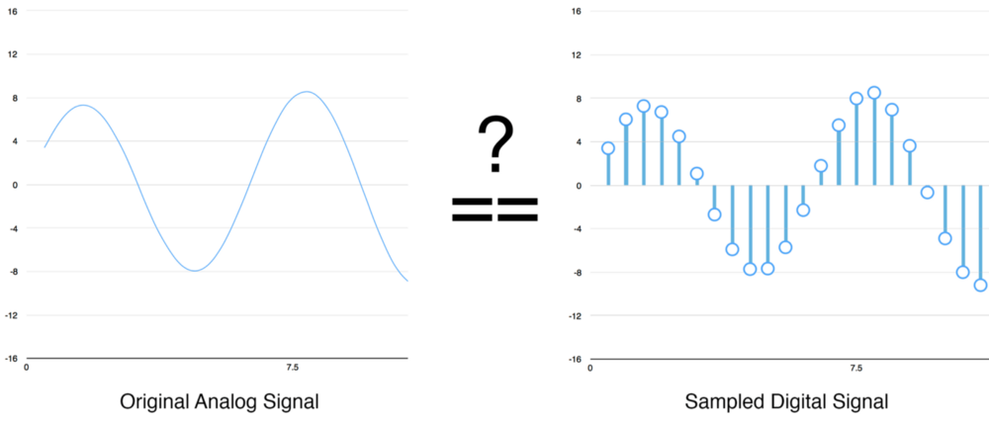
A Quick Sidebar
- Loosing our data while sampling, due to the gaps?
DIGITAL SAMPLING

Slide 40
Pre-processing our Sampled Sound Data
- We now have an array of numbers with each number representing the sound wave’s amplitude at 1/16,000th of a second intervals.
- some pre-processing is done on the audio data, instead of feeding these numbers right into a neural network.
- Let’s start by grouping our sampled audio into 20-millisecond-long chunks.

Slide 41
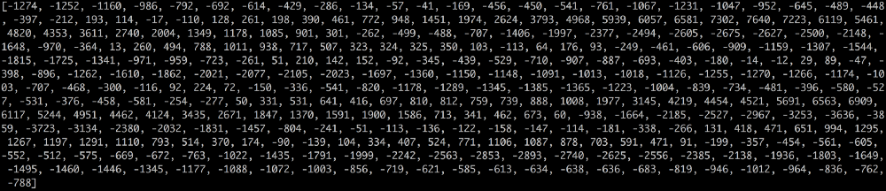
Here’s our first 20 milliseconds of audio (i.e., our first 320 samples):

Slide 42
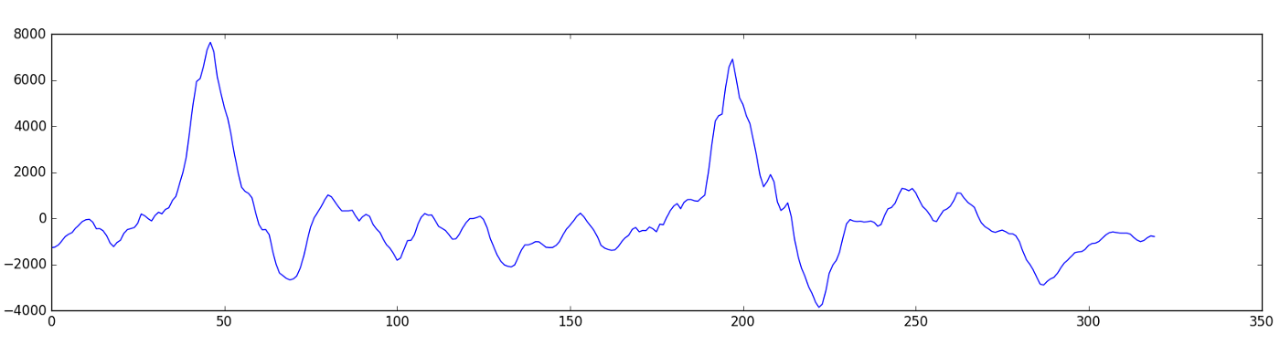
Plotting those numbers as a simple line graph gives us a rough approximation of the original sound wave for that 20 millisecond period of time:

Slide 43
To make this data easier for a neural network to process, we are going to break apart this complex sound wave into it’s component parts.
We’ll break out the low-pitched parts, the next-lowest-pitched-parts, and so on. Then by adding up how much energy is in each of those frequency bands (from low to high), we create a fingerprint for this audio snippet.
We do this using a mathematic operation called a Fourier transform.
It breaks apart the complex sound wave into the simple sound waves that make it up. Once we have those individual sound waves, we add up how much energy is contained in each one.

Slide 44
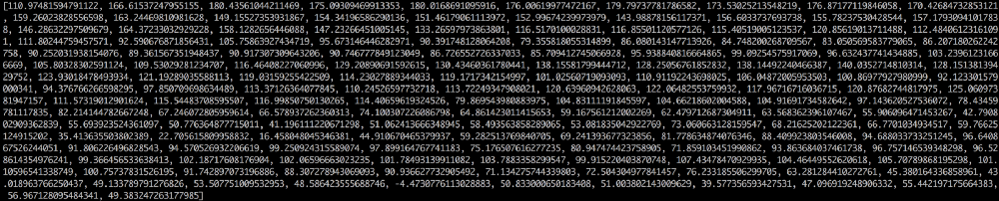
Each number below represents how much energy was in each 50hz band of our 20 millisecond audio clip:

Slide 45
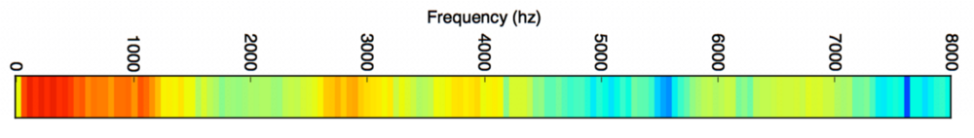
Lot easier on a chart:

Slide 46
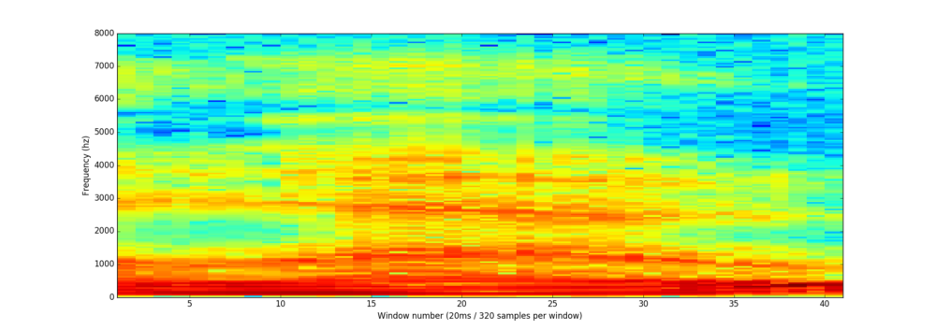
If we repeat this process on every 20 millisecond chunk of audio, we end up with a spectrogram (each column from left-to-right is one 20ms chunk):
The full spectrogram of the “hello” sound clip

Slide 47
Recognizing Characters from Short Sounds
Now that we have our audio in a format that’s easy to process, we will feed it into a deep neural network.
The input to the neural network will be 20 millisecond audio chunks.
For each little audio slice, it will try to figure out the letter that corresponds the sound currently being spoken.

Slide 48
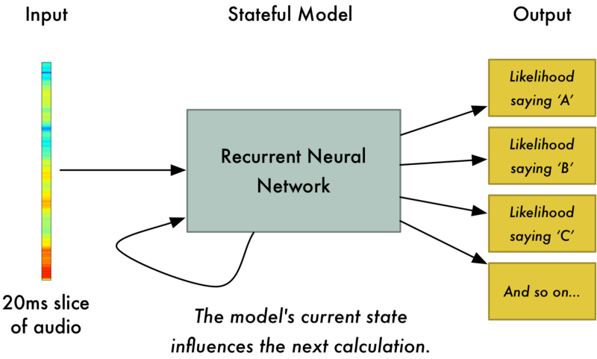

Slide 49
After we run our entire audio clip through the neural network (one chunk at a time), we’ll end up with a mapping of each audio chunk to the letters most likely spoken during that chunk.
Here’s what that mapping looks like saying “Hello”:

Slide 50
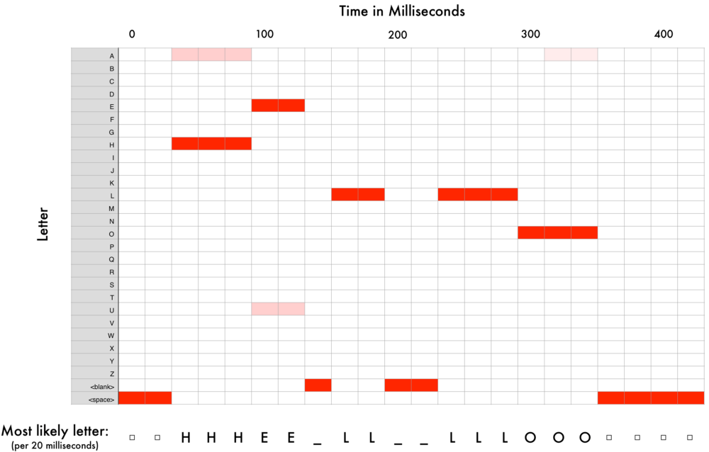

Slide 51
Our neural net is predicting that one likely thing that were said was “HHHEE_LL_LLLOOO”. But it also thinks that it was possible that it could be “HHHUU_LL_LLLOOO” or even “AAAUU_LL_LLLOOO”.
We have some steps we follow to clean up this output. First, we’ll replace any repeated characters a single character:
HHHEE_LL_LLLOOO becomes HE_L_LO
HHHUU_LL_LLLOOO becomes HU_L_LO
AAAUU_LL_LLLOOO becomes AU_L_LO

Slide 52
Then we’ll remove any blanks:
HE_L_LO becomes HELLO
HU_L_LO becomes HULLO
AU_L_LO becomes AULLO
That leaves us with three possible transcriptions — “Hello”, “Hullo” and “Aullo”.
The trick is to combine these pronunciation-based predictions with likelihood scores based on large database of written text.
Of our possible transcriptions “Hello”, “Hullo” and “Aullo”, obviously “Hello” will appear more frequently in a database of text and thus is probably correct. So we’ll pick “Hello” as our final transcription instead of the others. Done!

Slide 53
What the Future Holds
Voice will be a primary interface for the connected home, providing a natural means to communicate with alarm systems, lights, kitchen appliances, sound systems and more, as users go about their day-to-day lives.
More and more major cars on the market will adopt intelligent, voice-driven systems for entertainment and location-based search, keeping drivers’ and passengers’ eyes and hands free.
Small-screened and screen less wearables will continue their upward climb in popularity.
Voice-controlled devices will also dominate workplaces that require hands-free mobility, such as hospitals, warehouses, laboratories and production plants.
Intelligent virtual assistants built into mobile operating systems keep getting better.

Slide 54
[~] $ Questions_?

